Slide 1
Splash Screen

Slide 2
Lesson Menu
Five-Minute Check (over Lesson 2–7)
Then/Now
New Vocabulary
Example 1: Write a Fraction as a Terminating Decimal
Example 2: Write Fractions as Repeating Decimals
Concept Summary: Fraction-Decimal Equivalents
Example 3: Real-World Example: Write a Fraction as a Decimal
Example 4: Compare Fractions and Decimals
Example 5: Real-World Example: Compare Fractions Using Decimals

Slide 3
5-Minute Check 1
Evaluate the expression |a| if a = –8.
A. –8
B.
C. 2
D. 8

Slide 4
5-Minute Check 2
Evaluate the expression b + c if b = 2 and c = –5.
A. –7
B. –3
C. 3
D. 7

Slide 5
5-Minute Check 3
Evaluate the expression –3a if a = –8.
A. 24
B. 18
C. –11
D. –24

Slide 6
5-Minute Check 4
Evaluate the expression c – a if a = –8 and c = –5.
A. –13
B. –12
C. 3
D. 13

Slide 7
5-Minute Check 5
A. –8
B. –4
C.
D. 4

Slide 8
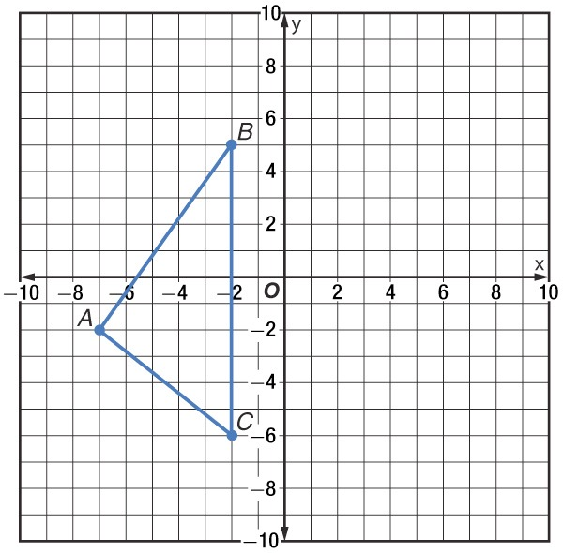
5-Minute Check 6
Triangle ABC is shown on the coordinate plane. Find the coordinates of the vertices of the image of the triangle ABC reflected over the y-axis.
A'(7, 2), B'(2, 3), C'(2, 6)
B. A'(–7, 2), B'(–2, –3), C'(–2, 6)
C. A'(7, –2), B'(2, 5), C'(2, –6)
D. A'(–7, –2), B'(–2, 3), C'(–2, –6)

Slide 9
Then/Now
You have used a number line to graph integers. (Lesson 2–1)
Write fractions as terminating or repeating decimals.
Compare fractions and decimals.

Slide 10
Vocabulary
terminating decimal
repeating decimal
bar notation

Slide 11
Example 1
Write a Fraction as a Terminating Decimal
Method 1 Use paper and pencil.
Place the decimal point. Annex zeros and divide as with whole numbers.
Division ends when the remainder is 0.

Slide 12
Example 1
Write a Fraction as a Terminating Decimal
Method 2 Use a calculator.
÷
1 16 0.0625
ENTER

Slide 13
Example 1
A. 0.58
B. 0.625
C. 0.725
D. 5.8

Slide 14
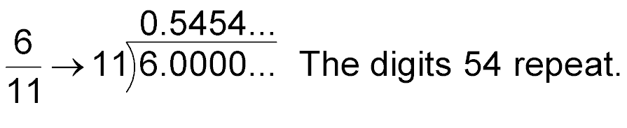
Example 2
Write Fractions as Repeating Decimals

Slide 15
Example 2
Write Fractions as Repeating Decimals
B.
The digits 12 repeat.
Answer: So, .

Slide 16
Example 2
A.
A.
B.
C.
D.

Slide 17
Example 2
B.
A.
B.
C.
D.

Slide 18
Concept

Slide 19
Example 3
Write a Fraction as a Decimal
SOCCER Camille’s soccer team won 32 out of 44 games to make it to the championships. To the nearest thousandth, find the team’s rate of winning.
Divide the number of games they won, 32, by the number of games they played, 44.
Look at the digit to the right of the thousandths place. Round down since 2 < 5.
Answer: Camille’s soccer team won 0.727 of the time.

Slide 20
Example 3
FIELD TRIPS The results of a poll showed that 16 out of 24 students in Ms. Brown’s class would prefer going to the planetarium rather than the arboretum. To the nearest thousandth, what part of the class preferred going to the planetarium?
A. 0.007
B. 0.667
C. 0.700
D. 16.24

Slide 21
Example 4
Compare Fractions and Decimals
A.
Write the sentence.
In the tenths place, 7 > 6.
Answer:

Slide 22
Example 4
Compare Fractions and Decimals
Write the fractions as decimals and then compare the decimals.

Slide 23
Example 4
Compare Fractions and Decimals

Slide 24
Example 4
A. <
B. >
C. =
D. none of the above

Slide 25
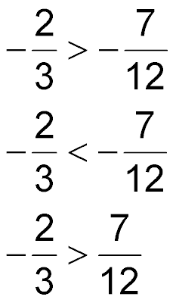
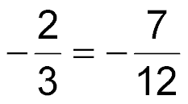
Example 4
B. Which statement is true?
A.
B.
C.
D.

Slide 26
Example 5
Compare Fractions Using Decimals
GRADES Jeremy got a score of on his first quiz and on his second quiz. Which grade was the higher score?
Write the fractions as decimals and then compare the decimals.
Answer: The scores were the same, 0.80.

Slide 27
Example 5
BAKING One recipe for cookies requires of a cup of butter and a second recipe for cookies requires of a cup of butter. Which recipe uses less butter?
A. the first recipe
B. the second recipe
C. both use the same amount
D. cannot be determined

Slide 28
End of the Lesson

